Slide 1
Maps 101 | Introduction to Geography Shelley E. Rose Cleveland State University
“Not only is it easy to lie with maps, it’s essential.”
Mark Monmonier, author of
How to Lie with Maps (1996), p. 1
Notes:
West Wing Clip https://www.youtube.com/watch?v=vVX-PrBRtTY

Slide 2
What’s Wrong with the Mercator Projection?
“To portray meaningful relationships for a complex, three-dimensional world on a flat sheet of paper… a map must distort reality.” Monmonier, 1996
This 4 min West Wing clip sums it up nicely...

Slide 3
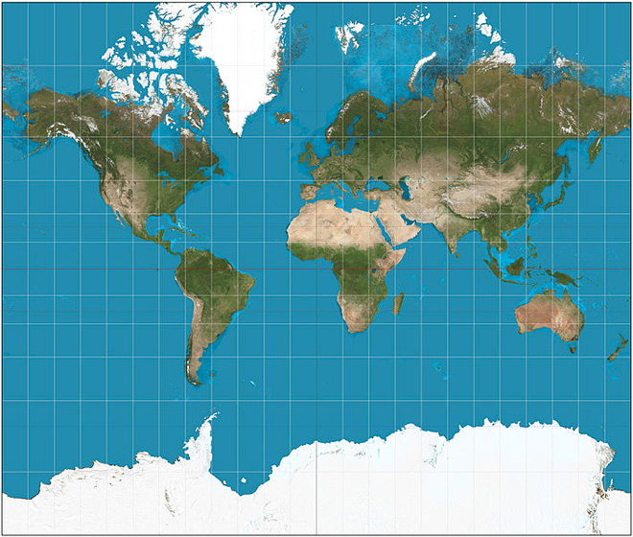
The Mercator Projection Today
The Mercator projection is still in use today- where have you used a Mercator map lately?
Read: “Get to Know a Projection”
There have been many attempts to develop a more accurate projection since Mercator drew his map in 1569. To see a few, visit WIRED magazine’s “Get to know a projection” series and check out this solution, which won Japan’s Good Design Award in 2016
Notes:
http://www.colorado.edu/geography/gcraft/notes/mapproj/mapproj_f.html
West Wing Clip https://www.youtube.com/watch?v=vVX-PrBRtTY

Slide 4
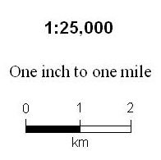
Elements of a Map
Title
Legend/Key
Scale (3 types)
Ratio
Verbal
Graphic
The Danger of =
Cartographer
Year Produced
Source(s)
Graphic Scales are **safest/clearest**
Notes:
Graphic scales will shrink and expand with map resizing

Slide 5
Where does it come from?
Size of Scale | Representative Fraction (RF)
Large Scale | 1:25,000 or larger
Small Scale | 1:500,000 or smaller
Notes:
Numbers from Monmonier, How to Lie with Maps 1996, p 6

Slide 6
Types of Maps
The three common types of maps are:
Political: shows human created boundaries like national boundaries, street names etc.
Physical: shows natural features of the earth, such as elevation, rivers, mountains etc.
Thematic: shows a particular subject, such as transportation, tourist attractions, migration patterns
Other maps include mental or cognitive maps- these subjective maps rely on the author’s perception of place in the space of a map. See slide 11 for examples.

Slide 7
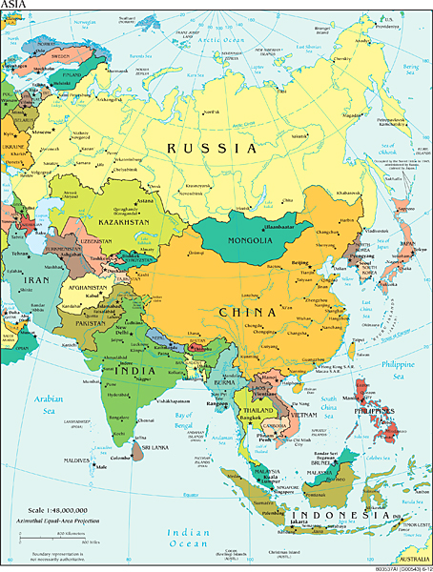
Political Map
Source: CIA World Factbook

Slide 8
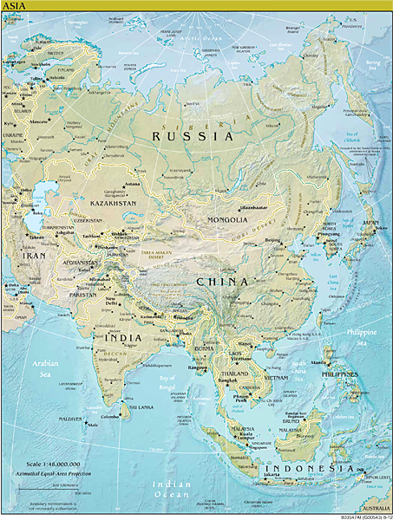
Physical Map
Source: CIA World Factbook
Notes:
https://www.cia.gov/library/publications/cia-maps-publications/map-downloads/India_Transportation.jpg
2001

Slide 9
Thematic Map
Transportation in India
Source: CIA World Factbook
Notes:
https://www.cia.gov/library/publications/cia-maps-publications/map-downloads/India_Transportation.jpg
2001

Slide 10
Thematic Map Example
Many thematic maps are interactive and cover a specific topic or theme. For examples, see these maps about Afghanistan from AlJazeera
https://www.aljazeera.com/news/2021/8/12/10-maps-to-understand-afghanistan-interactive

Slide 11
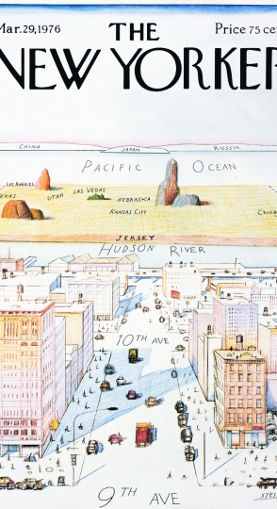
Mental or Cognitive Maps
“Mental maps are a mix of objective knowledge and subjective perceptions: precise knowledge about the location of geographic features as well as impressions of places, rough estimates of size and location, and a general sense of the connections between places.” – National Geographic
See this link about national geography standard #2: https://www.nationalgeographic.org/standards/national-geography-standards/2/

Slide 12
Guiding Questions for Map Reading
What is the subject? How can you tell?
What type of map is it?
What type of scale is included?
Who is the cartographer?
What year was the map published?
Who is the audience?
What is the purpose? How can you use it?
Describe how you would teach someone to use your map- be specific

