Slide 1
Flexible Learning II
Shelley E. Rose, Interim Director of the Center for Faculty Excellence, Cleveland State University
shelley.rose@csuohio.edu

Slide 2
UDL as Flexible Learning Strategy
Universal Design for Learning (UDL) is part of a larger movement of universal design, which works to increase access for all through designs that—from the beginning—consider needs of diverse people, not just adapting when a situation requires it. For instructors, UDL means designing your course with accessibility in mind—regardless of whether you’ve been approached by a student who may “require” such adjustments.
-Universal Design for Learning, Georgetown University

Slide 3
Reflect
What does UDL mean to you?
Do you use UDL strategies in your current practice?

Slide 4
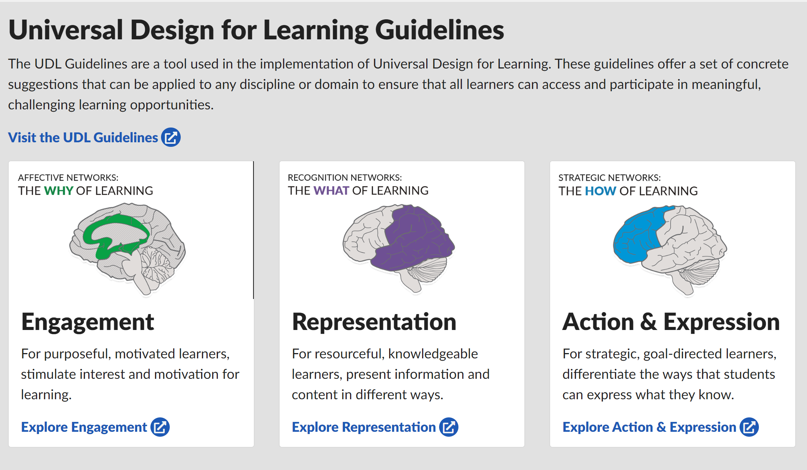
Source: https://www.cast.org/impact/universal-design-for-learning-udl

Slide 5
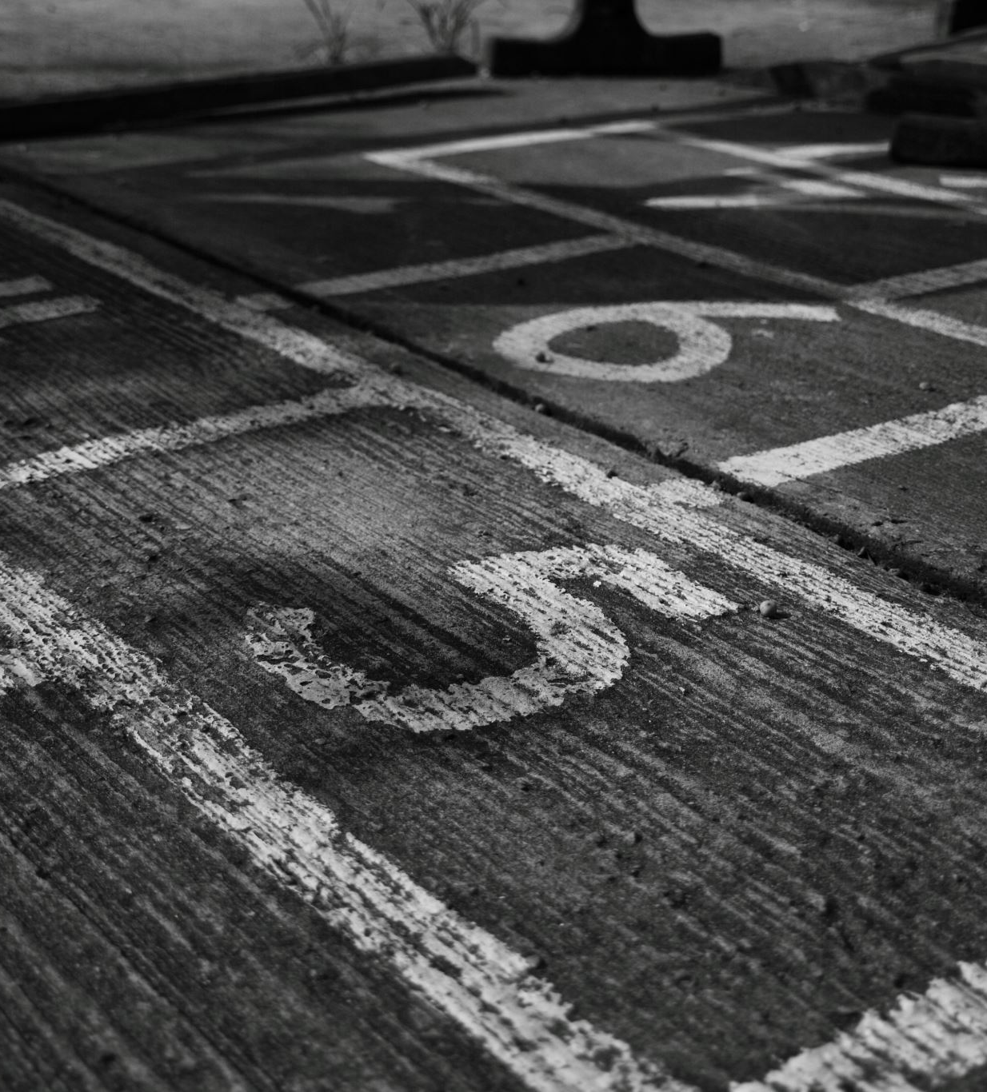
Practice Think | Pair | Share
Think of your current courses or instructional designs. Do you see UDL strategies in your existing designs?
How can you apply UDL guidelines in your future practice?
Do you have an assignment that could benefit from UDL?

Slide 6
Resources
Georgetown Center for New Designs in Learning & Scholarship
Center for Excellence in Universal Design, National Disability Authority
Cleveland Teaching Collaborative Resources on UDL
Think UDL Podcast https://thinkudl.org/
CAST UDL Resources

