Slide 1
Care & Wellness in your Syllabus
March 23, 2023
Center for Faculty Excellence
Shelley E. Rose, Interim Director
Care & Wellness in your syllabus poll: https://forms.office.com/r/i9TYHLiArCRE and Wellness in your Syllabus.pptx

Slide 2
CSU Resources for Syllabus Statements
Student Success Committee https://www.csuohio.edu/facultysenate/undergraduate-student-success-committee
SSC Syllabus Statements Library https://www.csuohio.edu/sites/default/files/Syllabus_Statements_%28Jan%202023%29_%281%29.pdf
SSC Syllabus Template
https://www.csuohio.edu/sites/default/files/Posted_to_Web_Template_for_CSU_Syllabi_04-19-2022.docx

Slide 3
How do you imagine wellness as part of your teaching?
Fill out this brief poll: https://forms.office.com/r/i9TYHLiArC

Slide 4
Syllabus Wellness Statements
From my current syllabus:
Wellness & Health
As your instructor I value your health and wellbeing. Success in this course, and in any college course, requires hard work balanced by attention to your mental and physical health. This includes the wellbeing of yourself and those you hold close.
I will challenge you to think critically and engage with new tools, skills, and methods in this course. There are weekly assignments and regular discussions. There are also spaces in this course for candid conversations, strategies for working remotely or in person, and private chats with the instructors. Reach out if you find yourself struggling. In the words of sociologist Nicole Gonzalez Van Cleve, “working until exhaustion is not a badge of honor; it shows you are out of balance.” We will all work together to help each other succeed in this course. At the end of the semester, I hope you feel proud of your growth and learning.

Slide 5
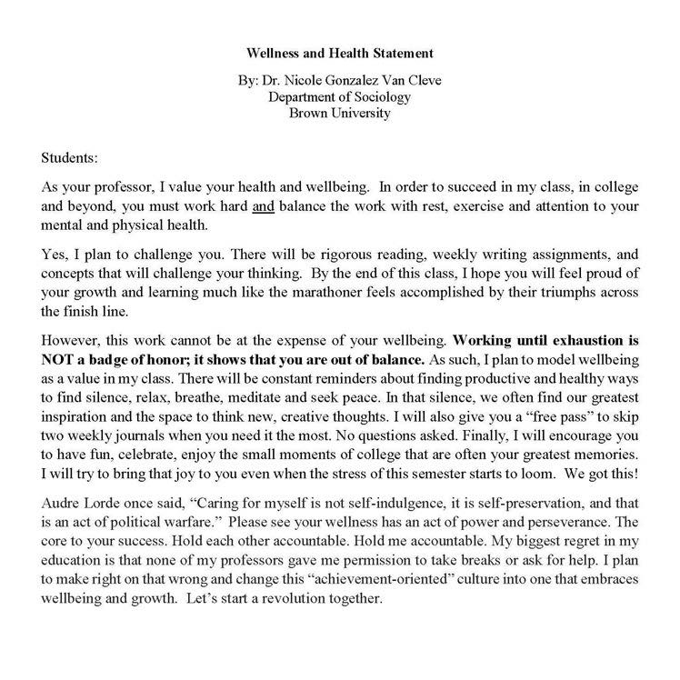
Nicole Gonzalez van Cleve
https://twitter.com/nvancleve/status/1428051054386688012/photo/1

Slide 6
Content & Care Strategies for your class
Assignment Completion Plan:
“Life happens, if you need more time for an assignment, please fill out this form to submit a completion plan: https://forms.office.com/r/rAM6tE6ySa”
Template: https://bit.ly/templatecompletionplan
“Get of Homework Free” or “Oh Fudge” tokens (names vary)
Each student in your class gets a named number of tokens for the semester that could be for a variety of things like missing an assignment, turning in something late, missing a class. The point is that no explanation is needed and that you clearly outline how to use them in your syllabus.

Slide 7
Questions & Sharing What wellness practices do you already use?
Next CFE workshop on Pedagogies of Care:
“Designing with (and for) Care: Lessons from the Cleveland Teaching Collaborative Community of Practice“
4/18 at 11:30 via Zoom

