Slide 1
Teaching the Cleveland International Film Festival:
Filmmaker Panels at the School of Film & Media Arts
Cigdem Slankard
Interim Director & Associate Professor
School of Film & Media Arts
Cleveland State University

Slide 2


Slide 3


Slide 4
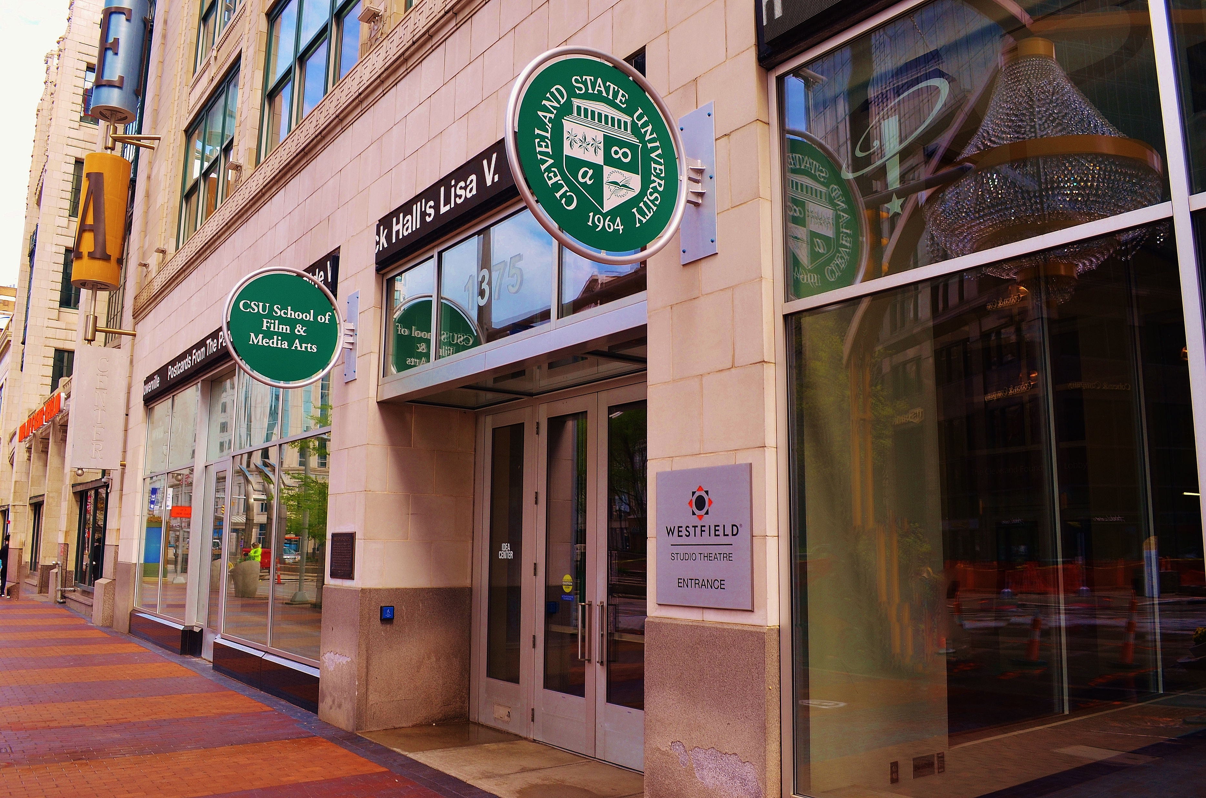
CSU - CIFF PARTNERSHIP
2006 - present
Notes:
12 years (2006 – 2019)
Sidebars and Film Series
Local Heroes film series sponsor / 2006 – 2019 (all 14 years)
Cinema en Español sidebar sponsor / 2006 – 2019 (all 14 years)
African Diaspora sidebar sponsor / 2008 – 2019
Pan Asian sidebar sponsor / 2008 – 2019
CSU connections throughout the years: (served on CIFF Board of Directors)
Njeri Nuru-Holm / 2006 – 2012
Byron White / 2013 – 2017
Frederic Lahey / 2017 – 2020

Slide 5
How Can CIFF Serve Educators?
FMA Perspective:
Focusing on both content/story and form/technique
Filmmakers as guest speakers at FMA
Valuable professional experiences for students, such as internships, volunteer work, temporary positions
Engagement within the community and broadening horizons beyond their local environments

Slide 6
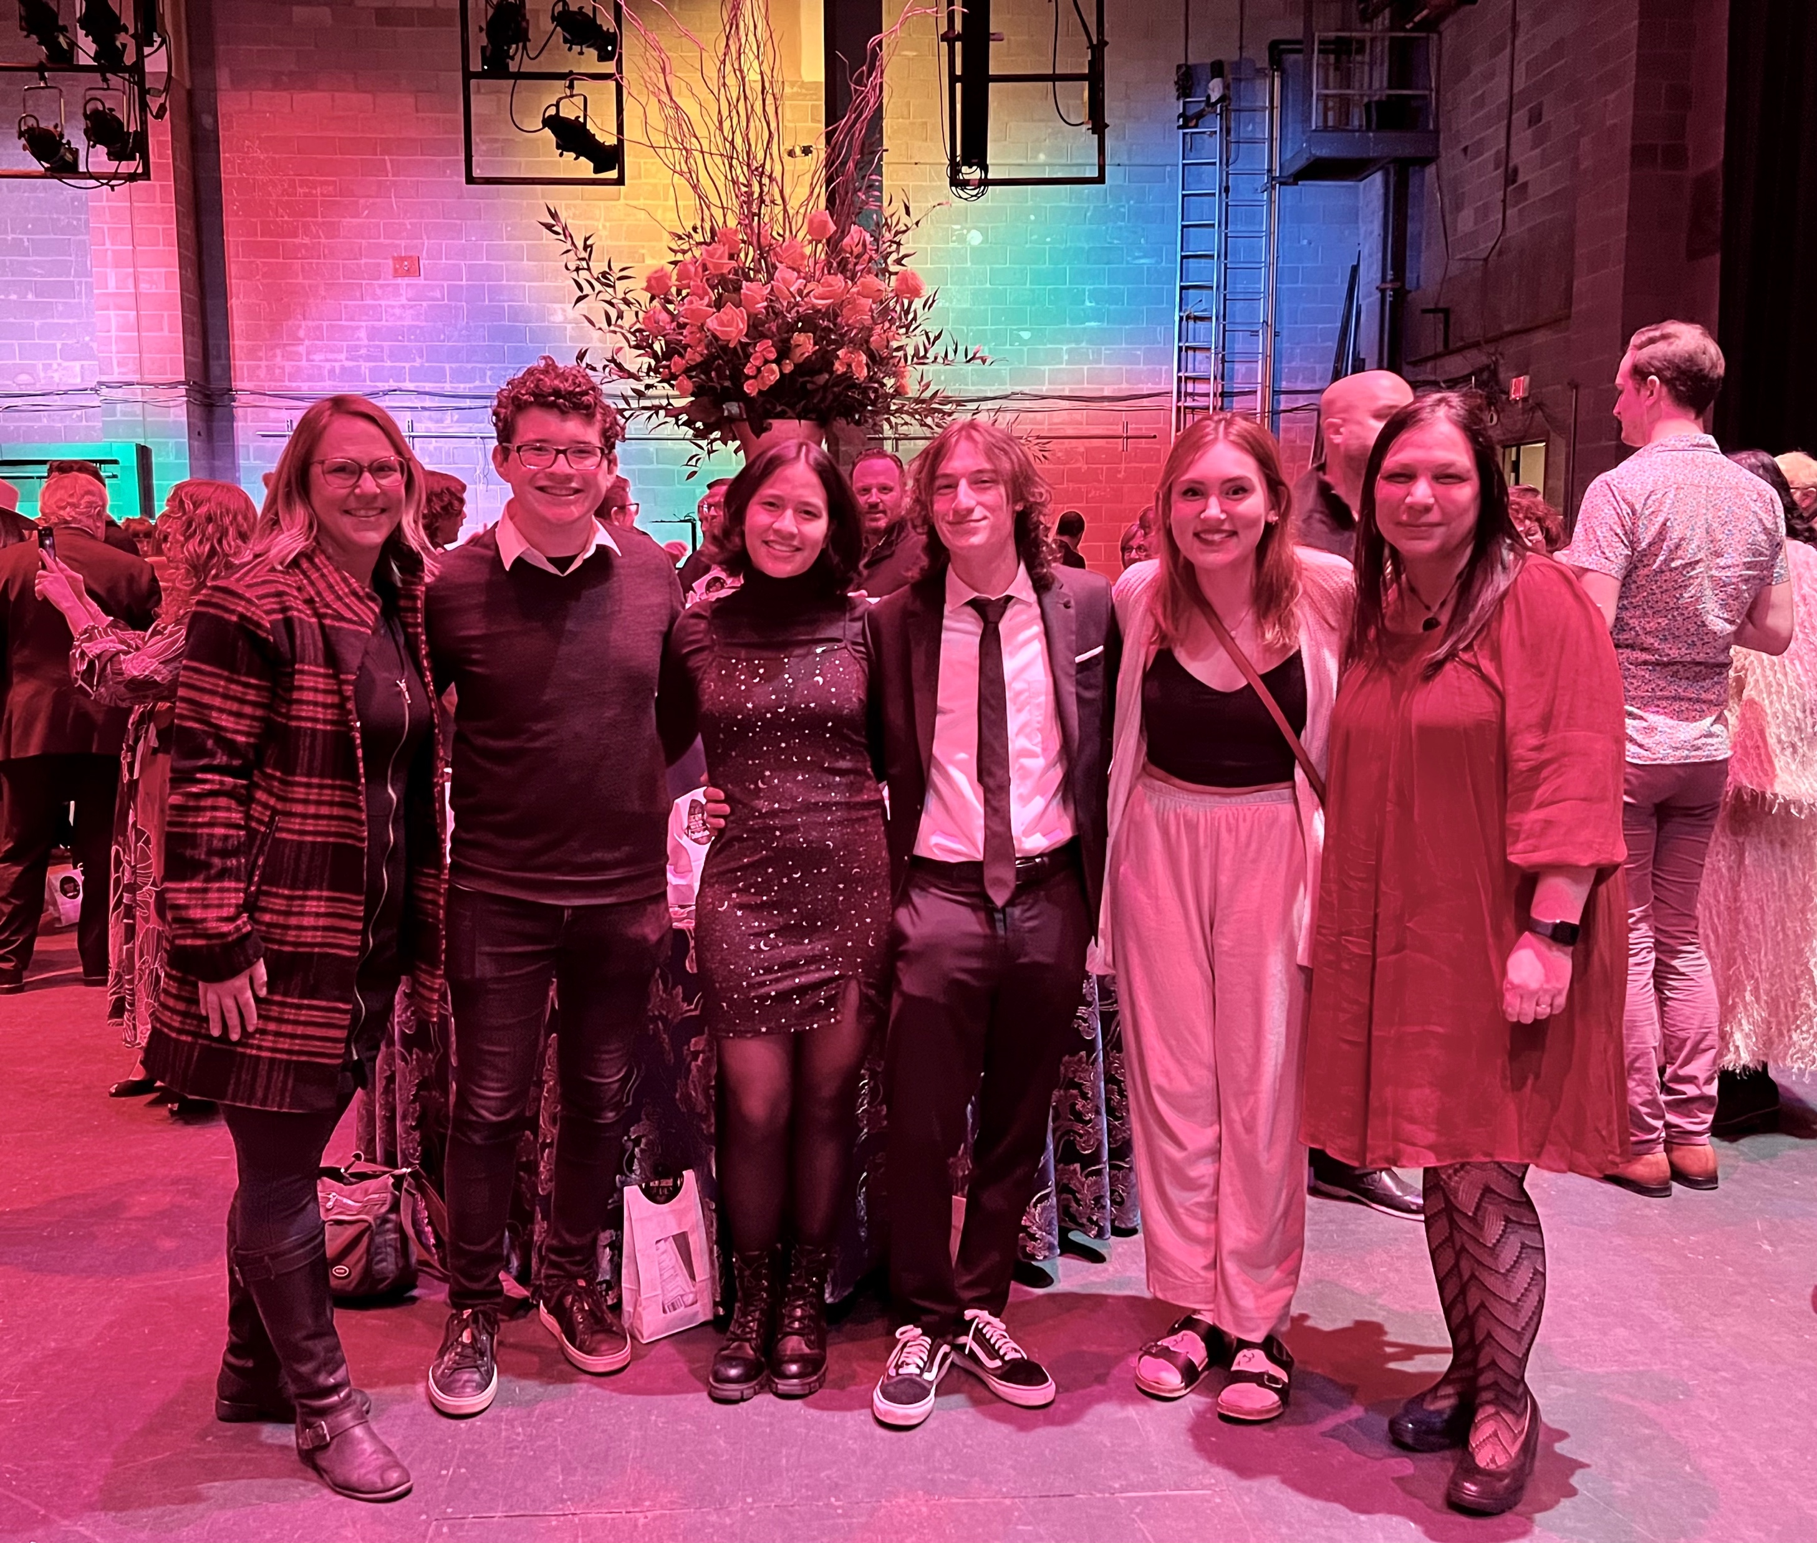
CIFF Opening Night, 2022
FMA students and faculty

Slide 7
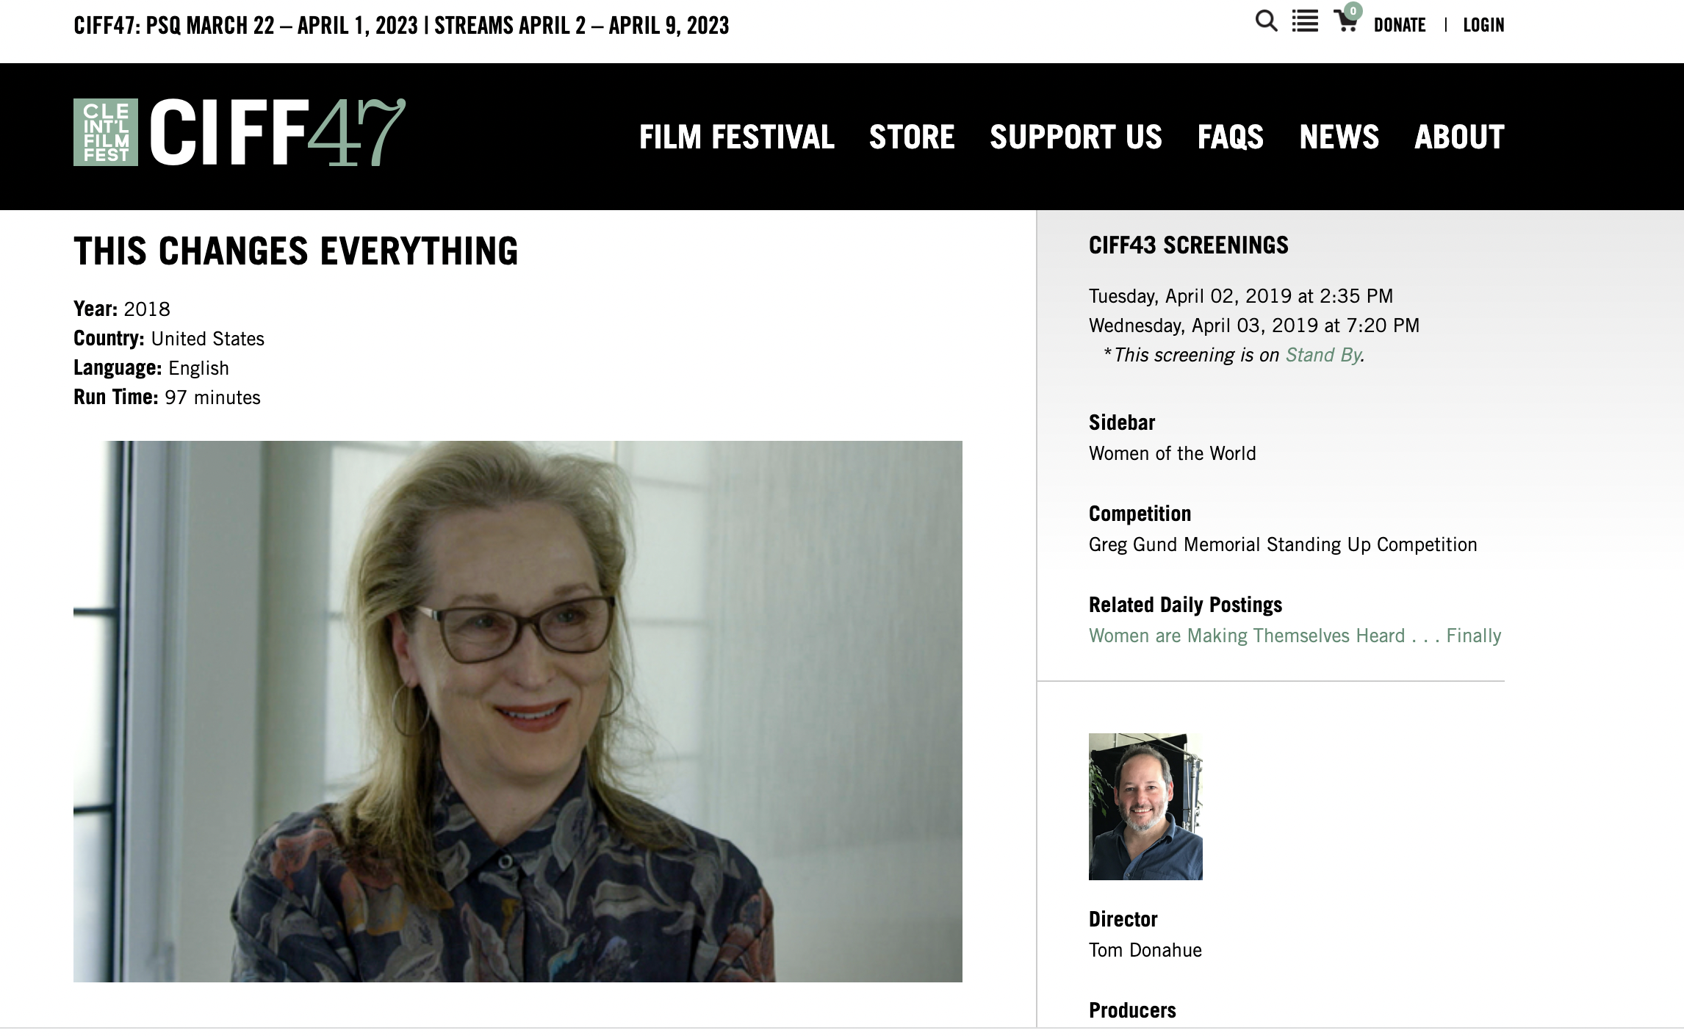

Slide 8
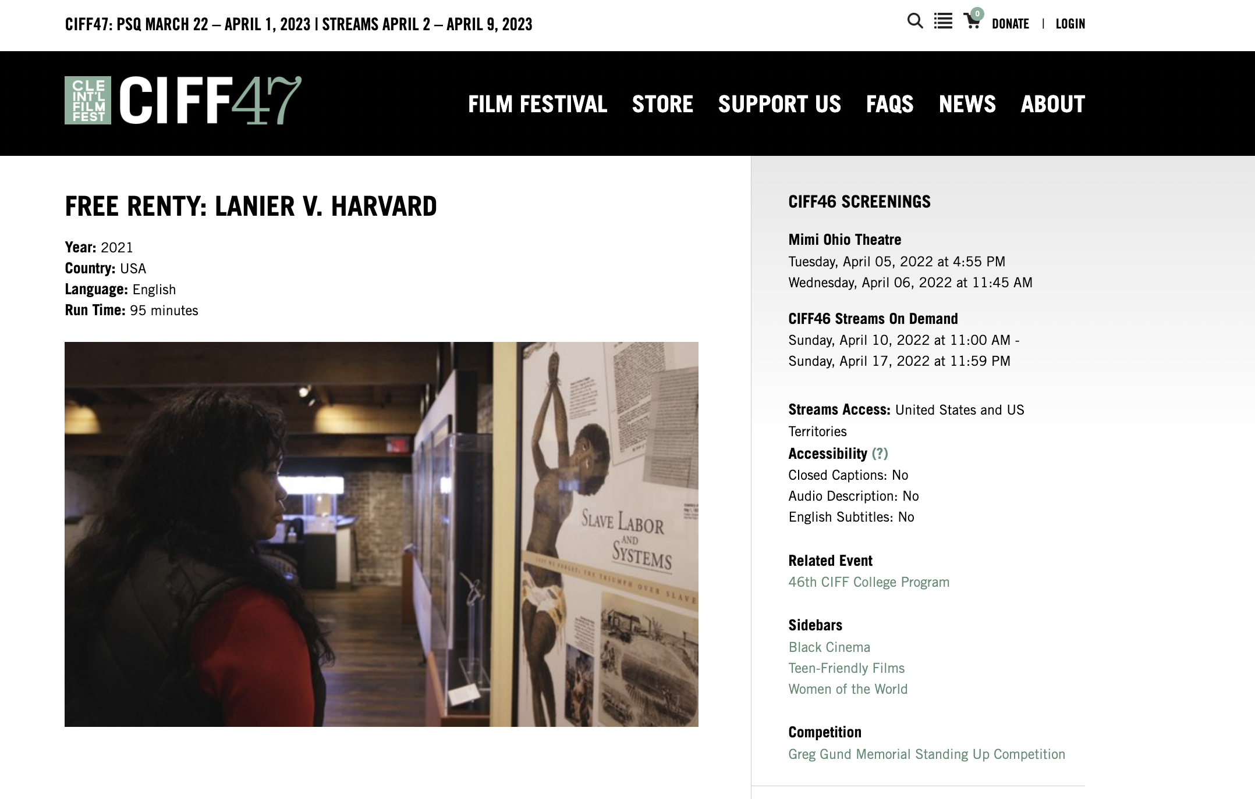

Slide 9
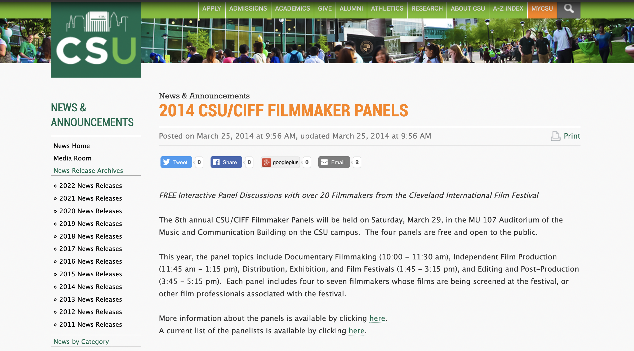
CIFF Filmmakers Panels at CSU
Started with the film program under the School of Communications

Slide 10

Relaunched in 2022 at FMA

Slide 11
Featuring filmmakers whose work is included in the 46th Cleveland International Film Festival and moderated by members of the CSU faculty, the panels will focus on the art, craft, business, and impact of film production for both narrative and documentary forms. Each panel will include an audience Q&A component. All panels are free and open to the public.

Slide 12
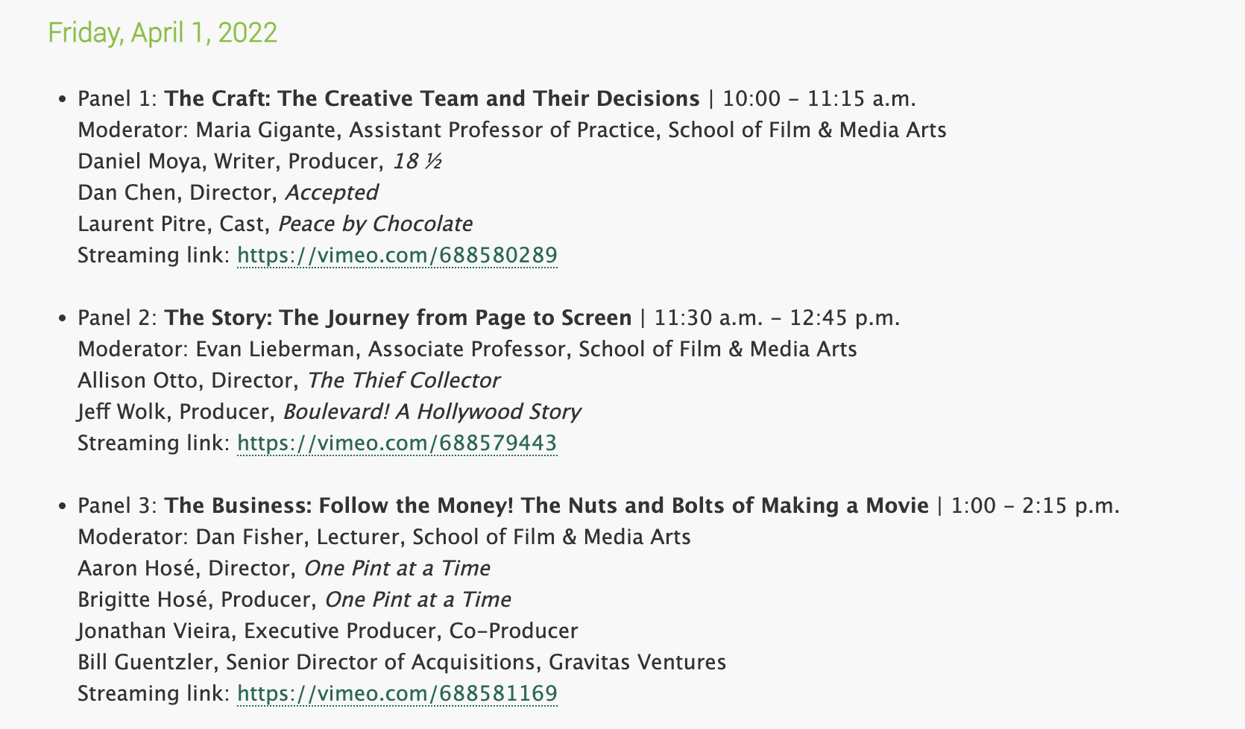

Slide 13
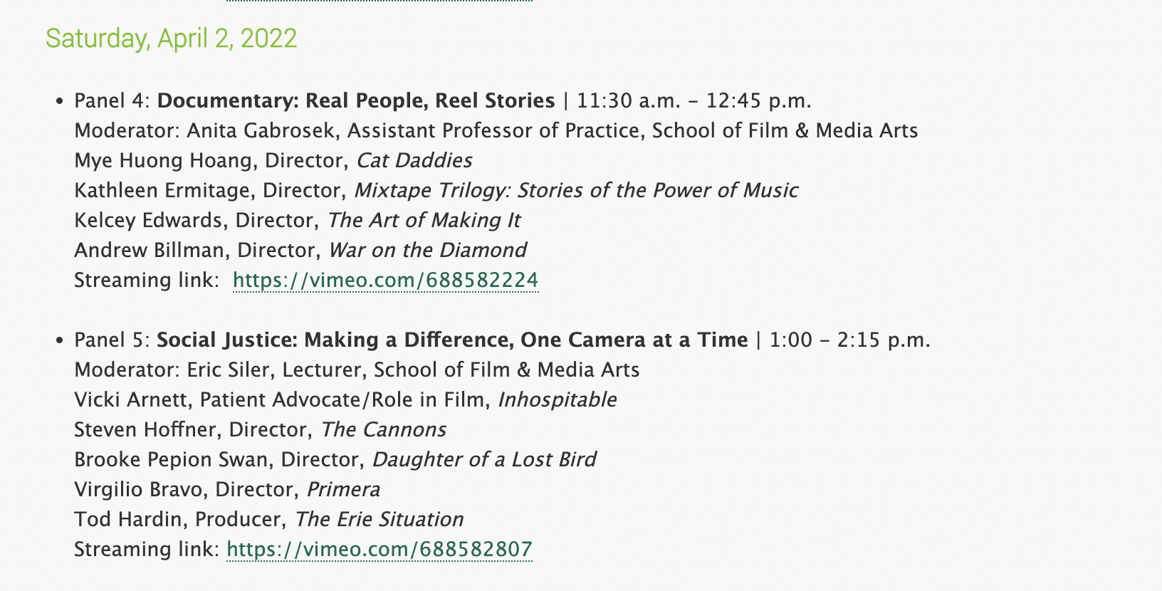

Slide 14
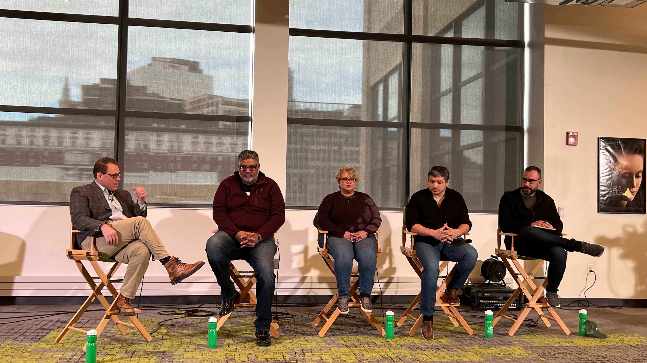

Slide 15
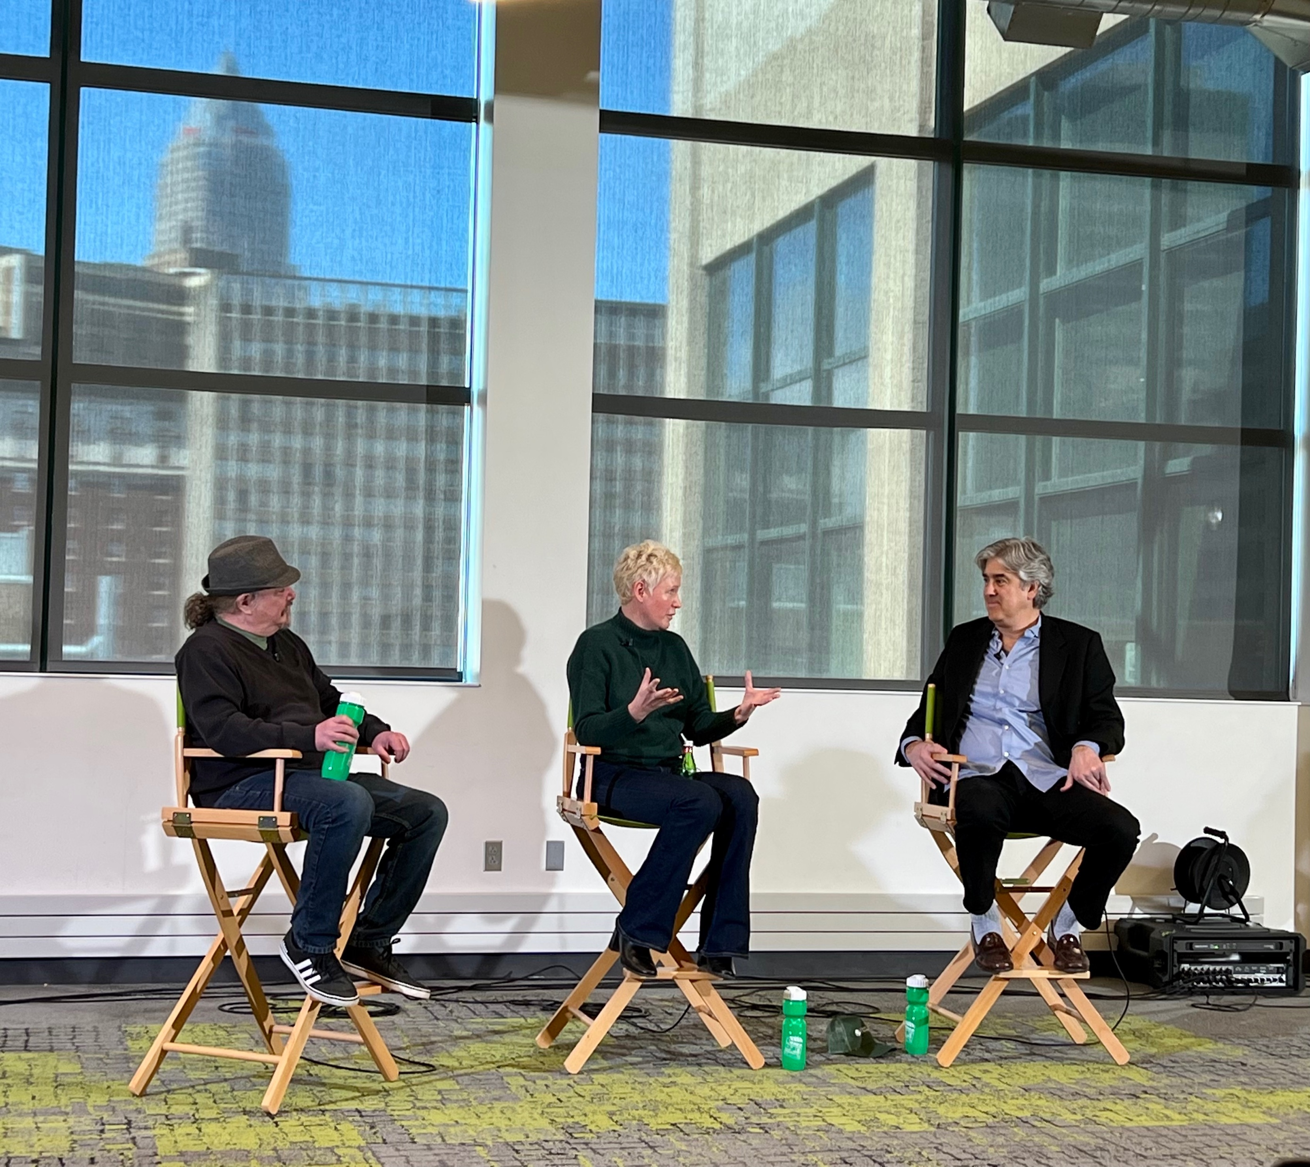
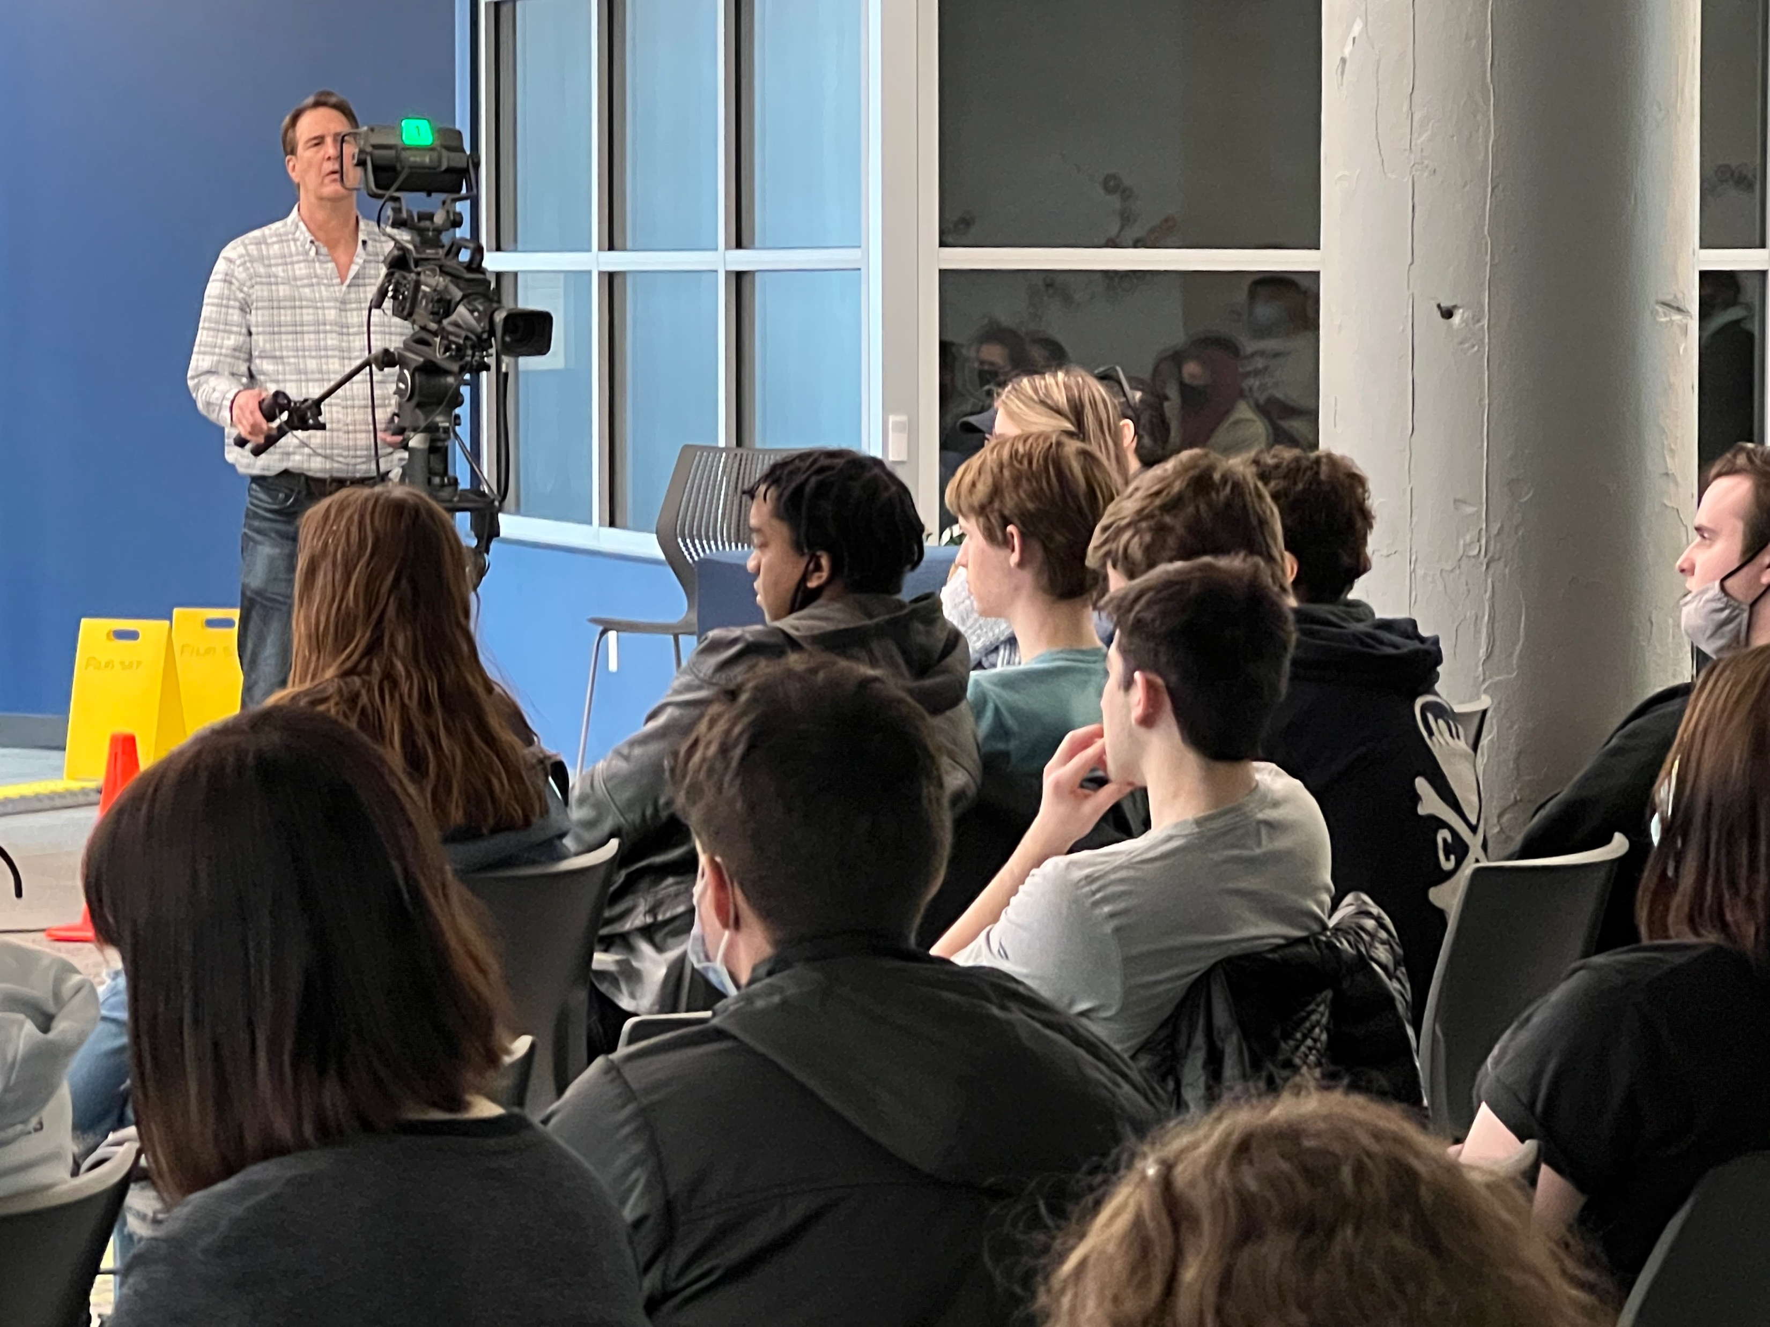

Slide 16
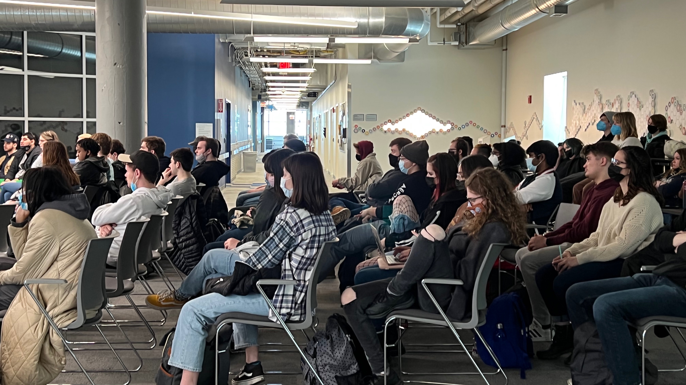

Slide 17

CIFF Filmmaker Panels
2023

Slide 18


Slide 19
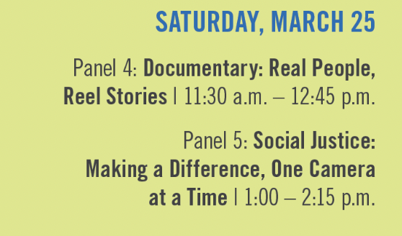

Slide 20
THANK YOU.
Cigdem Slankard
Interim Director & Associate Professor
School of Film & Media Arts
Cleveland State University
c.slankard@csuohio.edu

